Slide 1

BUSINESS PROJECT DOCUMENTATION
BY
KARTHIGA ELANGOVAN

Slide 2
INTRODUCTION
STARTUP NAME | MYNTRA
Headquarters | Bangalore, Karnataka, India
Sector | Ecommerce
Founders | Mukesh Bansal, Ashutosh Lawania, Vineet Saxena, Sankar Bora, and Raveen Sastry
Founded | 2007
Parent Company | Flipkart
Website | myntra.com

Slide 3
MYNTRA AS START-UP
In 2007, Mukesh Bansal left his Silicon Valley job to start his own company in India.
Inspired by unsold inventory in physical stores, he launched Myntra as an online platform for shoes, apparel, and accessories.
Initially focused on B2B sales of customizable gift products before shifting to individual customers.
By 2012, Myntra expanded to offer 360 Indian and global brands, becoming India's largest fashion eCommerce marketplace.

Slide 4
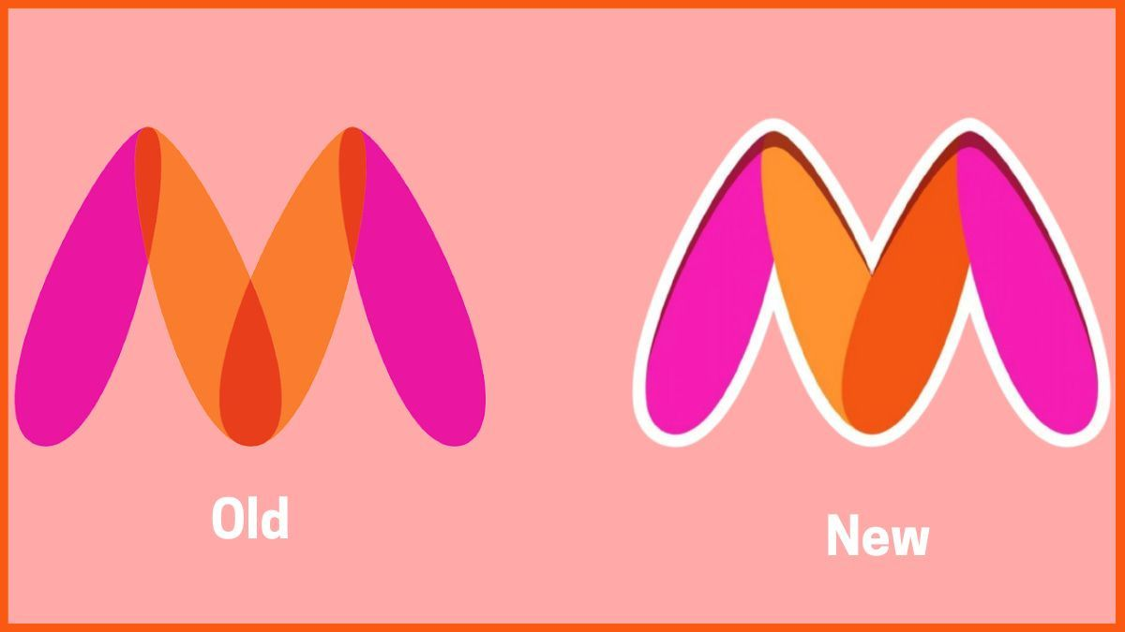
MYNTRA – MISSION AND LOGO
Myntra's mission and vision are to provide "a hassle-free and enjoyable shopping experience to shoppers across the country with the widest range of brands and products on its portal."

Slide 5
BUSINESS MODEL
Myntra transitioned from a B2B model to an aggregator B2C model, connecting consumers directly with brands.
Its business model includes:
Marketplace Model: Partners with various brands and retailers, offering over 3,000 domestic and international brands.
Private Labels: Owns private labels like Roadster and HRX, contributing significantly to sales.
Personalized Shopping: Leverages data analytics and AI for personalized recommendations.
Mobile-First Strategy: The Myntra app is a key driver of sales.
Flash Sales: Frequent sales events like the End of Reason Sale boost revenue.

Slide 6
MARKET POSITION AND GROWTH
It has 60 million average users as of March 2024
The company has over 6,000 brands as of March 2024
It has delivered to over 19,000 pin codes across India as of March 2024
It has 75 million new app users as of December 2023
Myntra offers products from more than 6,000 brands as of December 2022

Slide 7
REVENUE MODEL
Commission Fees: Earns 4% to 5% commission on products sold, depending on category and brand.
Marketplace Services: Generates revenue by providing a platform for brands and merchants to sell their products.
Logistics Services: Offers storage, packaging, and delivery services to customers, generating additional revenue.
Advertisement: Facilitates brand promotions on its platform, creating an extra income stream.
Other Resources: Diversifies revenue through additional financial strategies beyond core revenue streams.

Slide 8
FINANCIALS
Myntra Financials | FY22 | FY23
Operating Revenue | INR 3501.2 crore | INR 4375.3 crore
Total Expenses | INR 4206.9 crore | INR 5290.1 crore
Cost of Material Consumed | INR 1770.3 crore | INR 2165.7 crore
Employee Benefit Expenses | INR 522.5 crore | INR 631.8 crore
Advertising Expenses | INR 1298 crore | INR 1758.8 crore
Net Loss/Profit | Loss of INR 597.6 crore | Loss of INR 782.4 crore

Slide 9
BEST ONLINE SHOPPING SITES IN INDIA FOR CLOTHES
Platform Name | Website | Monthly Website Visitors
Myntra | https://www.myntra.com | 103.7 million
Ajio | https://www.ajio.com | 30.5 million
Amazon | https://www.amazon.in | 379.7 million
Flipkart | https://www.flipkart.com | 279.3 million
Tata CLiq | https://www.tatacliq.com | 9.7 million
LimeRoad | https://www.limeroad.com | 2.1 million
ZARA | https://www.zara.com/in | 96.4 million

Slide 10
COMPETITORS OF MYNTRA
Some of the prominent competitors of Myntra are:
LimeRoad
Meesho
Amazon
Ajio
Nykaa
Tata Cliq

Slide 11
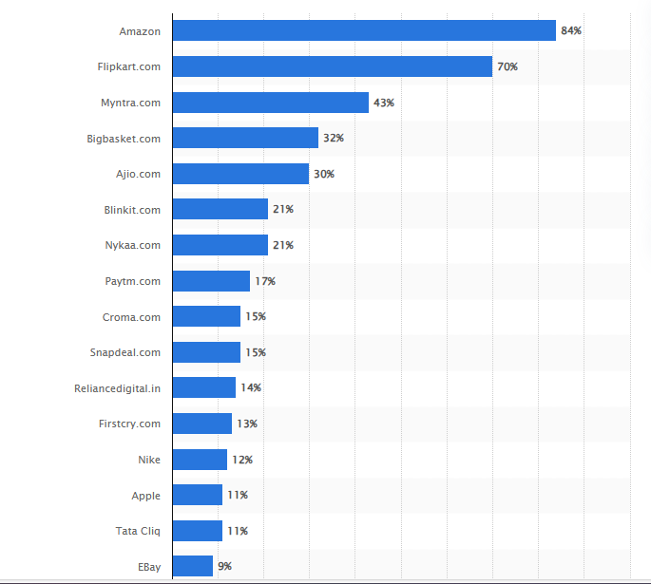
MOST POPULAR ONLINE SHOPS IN INDIA AS OF JUNE 2024

Slide 12
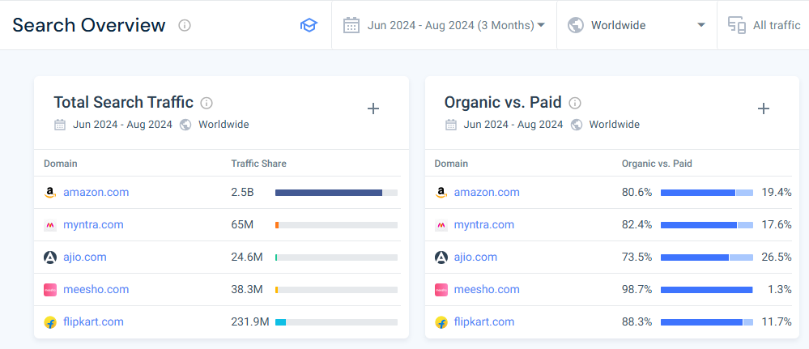
SEARCH TRAFFIC WITH COMPETITORS

Slide 13
TECHNOLOGY UTILIZATION
AI and Data Analytics: Uses AI-driven recommendations and data analytics to offer personalized shopping experiences.
Mobile App: Provides a user-friendly mobile app for seamless shopping, boosting customer engagement.
AR and Virtual Try-On: Implements augmented reality (AR) features for virtual try-on, enhancing the online shopping experience.
Cloud Computing: Leverages cloud infrastructure for scalability, secure data storage, and efficient operations.
Automation in Logistics: Utilizes automation technologies for efficient inventory management, packaging, and delivery processes.

Slide 14
SWOT ANALYSIS
STRENGTH | WEAKNESS
Strong brand recognition in Indian fashion eCommerce. | High dependency on fashion industry trends.
Wide range of Indian and global brands. | Intense competition from other online platforms.
Advanced technology integration (AI, AR, data analytics). | Logistics challenges in remote areas.
Strong mobile app and user interface. | Limited presence in international markets.
OPPORTUNITIES | THREATS
Expansion into Tier 2 and Tier 3 cities in India. | Competition from global players like Amazon and Flipkart.
Growth in fashion-conscious customer base. | Changing government regulations in eCommerce.
Adoption of sustainable and eco-friendly products. | Supply chain disruptions or logistical issues.
Leveraging social commerce and influencer marketing. | Economic downturns affecting purchasing power.

Slide 15
CUSTOMER SENTIMENT ANALYSIS
Methodology
Analyzed Social Media Platform ( Facebook, Instagram, Twitter ) and review Websites ( Trust Pilot and Google reviews).
Categorized reviews into High Impact, Low Impact and Medium Impact

Slide 16
HIGH IMPACT CONSUMER COMMENTS
Potential fraud and manipulation during sales, damaging trust.
Non-compliance with return and refund policies is a major concern for customer retention and legal implications.
Accusations of systematic fraud and manipulation of policies are severe and can lead to loss of customer trust and legal consequences.
Allegations of deleting reviews and avoiding accountability can significantly harm the brand image and lead to legal actions.
General dissatisfaction with post-purchase support, likely to impact a large segment of customers.

Slide 17
LOW IMPACT CONSUMER COMMENTS
Delays in delivery without proper communication are inconvenient but not as critical.
Poor handling of customer service requests but manageable.
Missed deliveries cause inconvenience but don’t indicate systematic issues.
Delivery issues are isolated but reflect gaps in operations.

Slide 18
MEDIUM IMPACT CONSUMER COMMENTS
Delivery and missing product issues can be resolved but contribute to poor customer satisfaction.
Poor service resolution and inconsistent policies around incomplete deliveries.
Perceived manipulation during sales, damaging customer trust in promotions.
Affects international customers who face added complications due to time constraints.

Slide 19
FINDINGS
High Impact: Severe issues such as fraud allegations, return/refund manipulation, and deletion of negative reviews.
Medium Impact: Delivery problems, missing products, and poor customer service resolution.
Low Impact: Delays in delivery, minor service gaps, isolated incidents of inconvenience.

Slide 20
COMPETITIVE ANALYSIS
Market Position & Brand Awareness
Myntra holds a strong brand presence in India but faces competition from Amazon Fashion and Flipkart in terms of customer base and market reach.
Product Range & Catalog
Wide selection of fashion brands and exclusive collaborations, but competitors like AJIO and Amazon offer a more diverse range across categories (electronics, lifestyle).
Customer Service & Returns
Myntra has faced criticism for poor customer service and complicated return processes, whereas Amazon is known for its seamless returns and faster resolutions.

Slide 21
STRATEGIC RECOMMENDATIONS
1. Enhance Customer Service & Support
Implement AI-driven chatbots for real-time assistance.
Create specialized teams for handling escalated issues.
Transparent ticketing system with real-time updates.
Set SLAs for complaint resolution with compensations for delays.
2. Strengthen Order Fulfillment & Delivery
Partner with reliable logistics for error-free deliveries.
Enable real-time order tracking.
Fast-track resolution for wrong/missing deliveries.

Slide 22
3. Simplify Returns & Refunds
Simplified, one-click return process.
Automated refund system for faster processing.
Trackable return/refund status for customers.
4. Rebuild Brand Image
Launch trust campaigns showcasing positive customer stories.
Collaborate with fashion influencers for reputation rebuilding.
Invest in CSR initiatives like sustainable fashion.

Slide 23
5. Improve Product Quality Control
Implement strict quality checks for vendors.
Regular third-party audits to ensure consistency.
Analyze customer feedback to address recurring quality issues.
Addressing customer pain points will drive loyalty and sales.
Prioritize service, transparency, and product quality to strengthen Myntra’s leadership in fashion e-commerce.

Slide 24
END

